Slide 1


PHP TRAINING
Introduction

Slide 2
What is PHP?
PHP was originally an acronym for Personal Home Pages, but is now a recursive acronym for PHP: Hypertext Preprocessor.
PHP was originally developed by the Danish Greenlander Rasmus Lerdorf, and was subsequently developed as open source. PHP is not a proper web standard - but an open-source technology. PHP is neither real programming language - but PHP lets you use so-called scripting in your documents.
To describe what a PHP page is, you could say that it is a file with the extension .php that contains a combination of HTML tags and scripts that run on a web server.

Slide 3
Introduction
PHP: Hypertext Preprocessor
PHP is dealt with before HTML
Lies between web server and HTML
Interpreted language (i.e. not compiled)
Code is interpreted on the fly
Code is in plain text so anyone with access to the web server can view it
However, code can still be encrypted so it can’t be stolen. Programs that enables you to encrypt your PHP codes include Zend Encoder (http://www.zend.com), SourceGuardian PHP Encoder (http://www.sourceguardian.com), ionCube PHP Encoder (http://www.ioncube.com), and PHP LockIt (http://www.phplockit.com)

Slide 4

Introduction
What to look for:
o Latest stable PHP version with MySQL version
o Determine type of access (FTP/SFTP/SSH/Telnet)
o Access to MySQL
o What kind of hosting contract? (better if you can leave anytime in case you do not like their service)
o Check reputation of provider
o Installer of Apache, PHP and MySQL
http://www.apachefriends.org XAMPP (Windows, Linux, Mac and other OS; free) http://www.mamp.info/en/index.html MAMP (for installation of Apache, Mysql and PHP on a Mac OS X)

Slide 5
Introduction
Hosting your PHP Application
• Sample PHP hosting sites (for a fee)
www.aws.amazon.com
www.justhost.com
www.bluehost.com
www.inmotionhosting.com

Slide 6
Introduction
PHP Sources of Information
http://php.net
www.stackoverflow.com
www.w3schools.com
http://www.zend.com
http://www.hotscripts.com

Slide 7
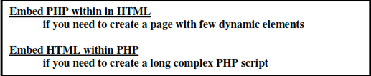
Introduction
PHP programming standards:
Goal is to make code easy to read and understand
However, there is no accepted industry coding standard
Each programmer is encouraged to come up with his own standard or if he’s a part of a company and the company has its own standard then he is required to follow that standard
Use comments but don’t comment everything coz that would required a huge amount of time.
// single line comment
#
/*
: multi-line comment
*/
Better if just make the code readable and simple
Also use indentation

Slide 8
Introduction
PHP Opening and Closing Tags
<?php
…
?>
- this setting is always acceptable in any PHP configuration
Note: Every PHP statement ends in a semi-colon (;)

Slide 9
Introduction
Sample PHP programs:
<?php
// save this as hello.php in your htdocs folder
echo “Hello World!”;
?>
<?php
// save this as info.php in your htdocs folder
phpinfo();
?>

Slide 10
Introduction
phpinfo() is a php function that outputs information about your PHP settings:
• Tells you the PHP version installed
• Status of PHP Core variables – note that there are Local and Master values. The Local value can be set on a page-by-page basis, by .htaccess file, or by a domain configuration. The master value is the global setting as specified in the php.ini (of which only the System Administrators have access

Slide 11
Introduction
PHP Variables
• Prefixed with a $ sign
• Must start with a letter or underscore ( _ )
• May contain letters, numbers, and underscore
• No spaces, ampersands, percent sign, etc. in variable names
• Case sensitive
Valid Variables |  | Invalid Variables | Reason why invalid
$first_name |  | $first name | Space in variable name
$lastname |  | $!LASTName | Can’t use ! in variable name
$_my_company |  | $ my_company | Space between $ and my_company
$_1_solution |  | $1_solution | Can’t start a variable name using a number

Slide 12
Introduction
PHP Constants:
• Will not change value
• Created using the define() functions
o Ex. define(“UNIVERSITY”, “University of the Philippines”);
• Must start with a letter or underscore ( _ )
• May contain letters, numbers, and underscore
• No spaces, ampersands, percent sign, etc in variable names
• By convention, constants are written in uppercase although that is not required
Valid Constants |  | Invalid Constants | Reason why invalid
define(“first_name”, “Harry”); |  | define(“first name”, “Harry”); | Space in constant name
define(“LASTNAME”, “Potter”); |  | define(“!LASTNAME”, “Potter”); | Can’t use ! in constant name
define(“_my_company”, “CPI”); |  | define(“my company”, “CPI”); | Space in constant name
define(“_1_solution”, “mysolution”); |  | define(“1_solution”, “my solution”); | Can’t start a constant name with a number

Slide 13
Introduction
PHP Statements
o What the interpreter executes
o Ends in a semi-colon ( ; )
TYPES of PHP VARIABLES
Note: Many programming languages force you to pre-define your variable types (which is called type-casting). In PHP, type-casting is done by the PHP interpreter. PHP allows you to change the variable type anywhere within the program (i.e in one line of the program, its value is a string then in another line in the same program, its value will be changed to number)
1. NUMERIC
2 Types of Numeric include
a. INTEGER
b. REAL (floating type) : by default it is a DECIMAL value i.e. in base10.
If you want to store a Hexadecimal value (base16), prefix value with a 0x. If you want it octal (base8), prefix it with a single zero ( 0 )
Ex. $age = 10;
$GWA = 1.27;
$hex_value = 0xC4;
$octal_value = 024;

Slide 14
Introduction
2. STRING
o Represented as pieces of texts
o Proper term for string is a collection of bytes in a specific order
o Can contain text or binary data
o Can be declared using double quotes or single quotes

Slide 15
Introduction
Ex.
<?php
$name = “My name is “Harry”, at your service!”;
echo $name;
?>
will produce a parse error coz interpreter is confused with so many double quotes. So escape the double quotes in Harry
<?php
$name = “My name is \“Harry\”, at your service!”;
echo $name;
?>
no more error
will print onscreen: My name is “Harry”, at your service!

Slide 16
Introduction
Single quotes are interpreted literally (i.e. does not substitute value of variables). Let’s compare the effect of double quotes and single quotes in the next program:
<?php
$name = “Harry”;
print “Hello, my name is $name. How are you?”;
print “<br>”;
print ‘Hello, my name is $name. How are you?’;
?>
Notice the output:
Hello, my name is Harry. How are you?
Hello, my name is $name. How are you?

Slide 17
Introduction
3. BOOLEAN
• Has 2 possible values (true or false)
• Used to control flow of control especially in conditional statements or looping Statements
TRUE | FALSE
$pass = true; | $pass = false;
$pass = 1; | $pass = 0;
$pass = 1; | $pass = ‘ ’; //NULL //i.e. no space between 2 single quotes

Slide 18
Introduction
4. ARRAY
• Uses one variable name but can store a number of values (which we call elements)
• Has an index
• We can refer to each element in the array through the index
5. OBJECT
• Self-contained collections of code and data and are the core of object-oriented programming in PHP
6. NULL
• Data type used to specify that the variable has no value
Ex. $total_applicants = NULL;
$skills = “”;
7. RESOURCE
• References something external such as database or file connection

Slide 19
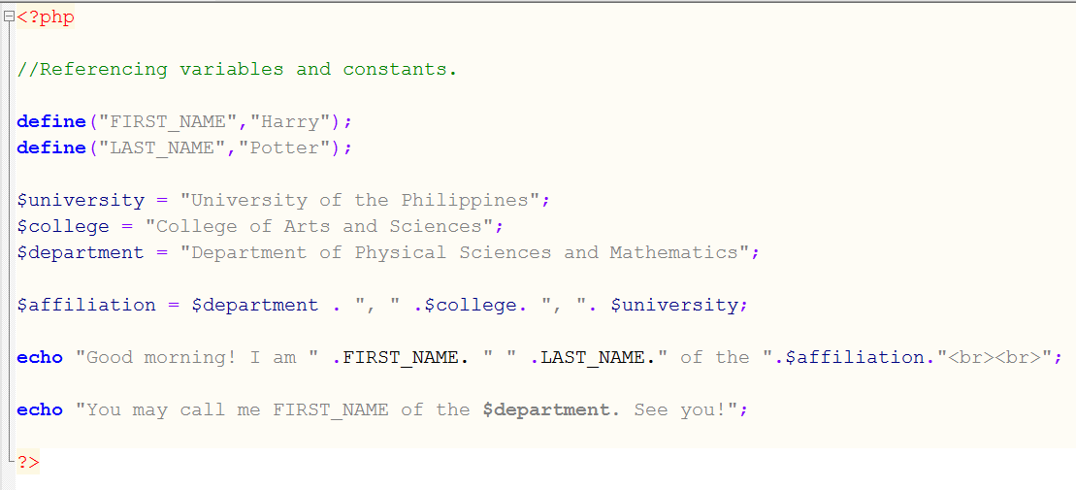
Introduction
Sample programs
Errors in the script: referencing_variables_and_constants.php:
The last print statement is in error. Since what you want is for PHP to print “Harry” and not FIRST_NAME, you should place the constant FIRST_NAME outside the double quotes
Note also that to concatenate strings, we use the period. If period is inside the double quotes, it will not be treated as a concatenation operation but will simply print the period

Slide 20
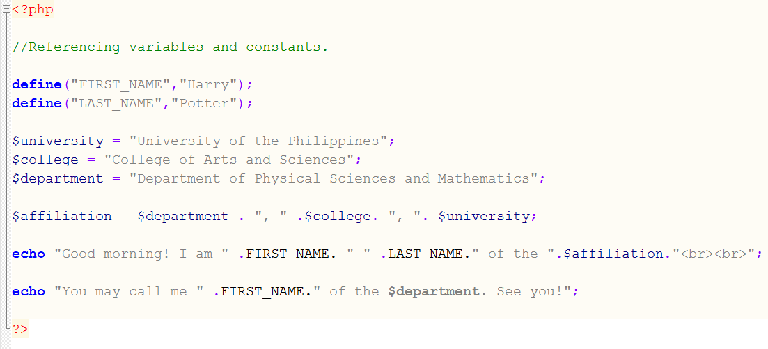
Introduction
The corrected version of the above program is shown below:

Slide 21
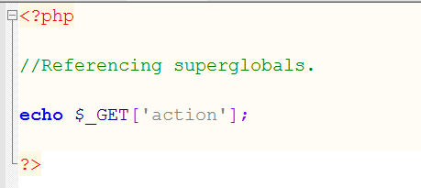
Introduction
8. SUPERGLOBALS
• Special variables that are created and defined by the PHP interpreter
• Includes $GLOBALS, $_GET, $_POST, $_REQUEST
• The $GLOBALS array contains all sorts of information such as the URL, environment settings, etc.
• The $_GET array contains information passed into your script via the GET HTTP method. With $_GET, values are passed to the URL
• The $_POST array contains information passed into your script via the POST HTTP method
• The $_REQUEST array contains all the combined information of the $_GET and $_POST arrays
• Other superglobals are the $_SERVER, $_COOKIE, $_FILES, $_SESSION
Sample programs:

Slide 22
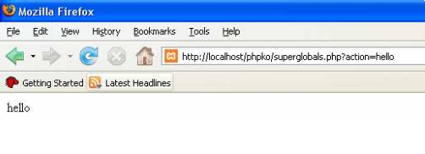
Introduction
To run this program open your browser and in the URL you type:
http://localhost/myphp/superglobals.php?action=hello

Slide 23
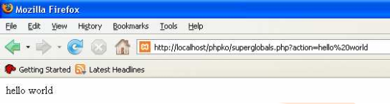
Introduction
then try also
http://localhost/myphp/superglobals.php?action=hello world
Note that the URL will be changed to
http://localhost/phpko/superglobals.php?action=hello%20world
(i.e. a %20 is inserted between hello and world)

Slide 24
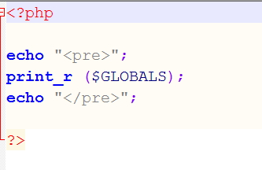
Introduction
Next let’s try to print the contents of the $GLOBALS array using the print_r() function

Slide 25
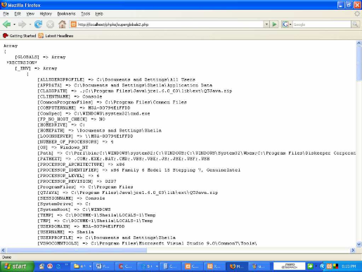
Introduction
This is the output of the $GLOBALS array:

Slide 26
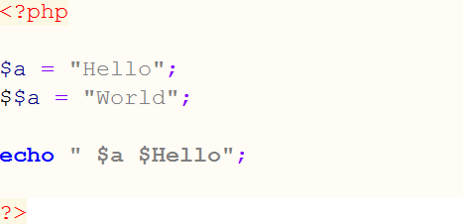

Introduction
9. VARIABLE VARIABLES
• Type of variable whose value are also variables
The code above will display:

Slide 27
Introduction
OPERATORS
• = - the assignment operator
• +, - *, / - you can use parenthesis as grouping symbols to make your formula more readable
Ex. $root = (-$b + (b*b – 4*a*c))/2*a;
• % - modulus operator (returns the remainder when 2 numbers are divided)
Ex. $remainder = 10%3 (will return 1)
• . - concatenator. This can be combined with = sign
Ex. $food = $food . “burger”; is the same as
$food .= “burger”;
• @ - error control operator. This is used so php wont display output. Use with caution
Ex. @$quotient = 10/0; this is an error but since there is a @ prefixed in the variable name, therefore the error wont be displayed. Makes finding errors a difficult process.

Slide 28
Introduction
• Increment (++) and decrement (--) operators. This is placed either before or after a variable.
• Prefixing: ++$a will increment the value then return the value (which is now incremented)
--$a will decrement the value then return the value (which is now
decremented)
• Postfixing: $a++ will return the value first then increment the value
$a-- will return the value first then decrement the value
• Comparison Operators: ==, !=, <, <=, >, >=
- returns a Boolean value
- i.e returns either true or false
- or returns either 1 or 0
- often used as conditions in conditional statements such as IF-THEN-ELSE, or looping statements
• Logical operators: and, &&, or, ||, xor, !

Slide 29
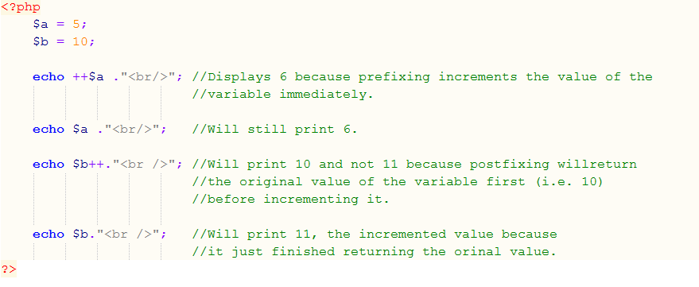
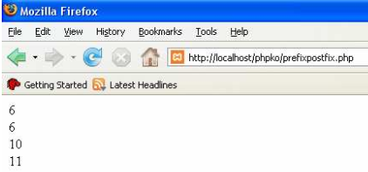
Introduction

Slide 30
Introduction
CONDITIONAL STATEMENTS
1. IF
Syntax: a) IF (condition)
{
Statement1;
Statement2;
:
}
b) IF (condition)
Statement;

Slide 31
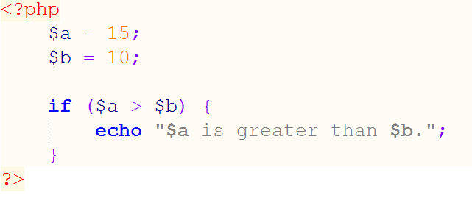

Slide 32
Introduction
2. IF – ELSE
Syntax: a) IF (condition)
{
Statement1;
Statement2;
:
}
ELSE
{
StatementA;
StatementB;
:
}
b) IF (condition)
Statement1;
ELSE
Statement2;

Slide 33
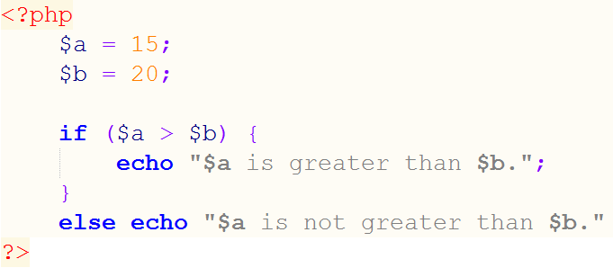

Slide 34
Introduction
3. ELSEIF
Syntax: a) IF (condition)
{
Statement1;
Statement2;
:
}
ELSEIF (condition)
{
StatementA;
StatementB;
:
}
ELSE
{
Statementa;
Statementb;
:
}

Slide 35
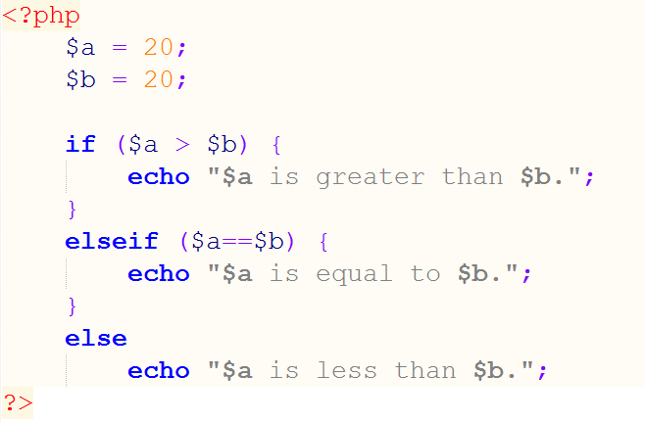

Slide 36
Introduction
4. NESTED IF’S
Syntax: a) IF (condition)
IF (condition)
{
Statement1;
Statement2;
:
}
ELSEIF (condition)
{
StatementA;
StatementB;
:
}
ELSE
{
Statementa;
Statementb;
:
}
ELSE
:
}

Slide 37
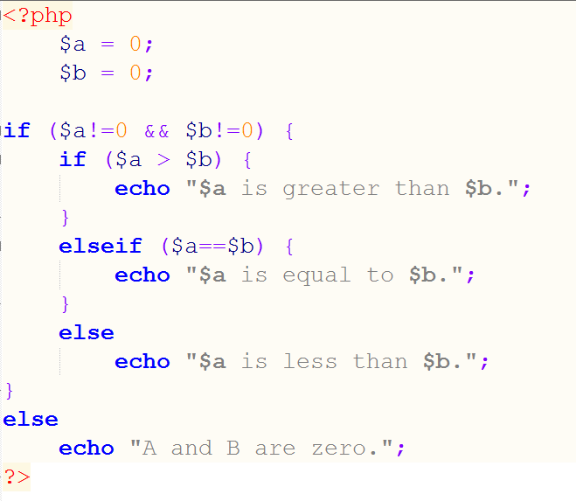

Slide 38
Introduction
5. SWITCH
Syntax: SWITCH (variable) {
CASE “value1”: {statements;}
break;
CASE “value2”: {statements;}
break;
CASE “value3”: {statements;}
break;
default: {statements;}
break;
}

Slide 39
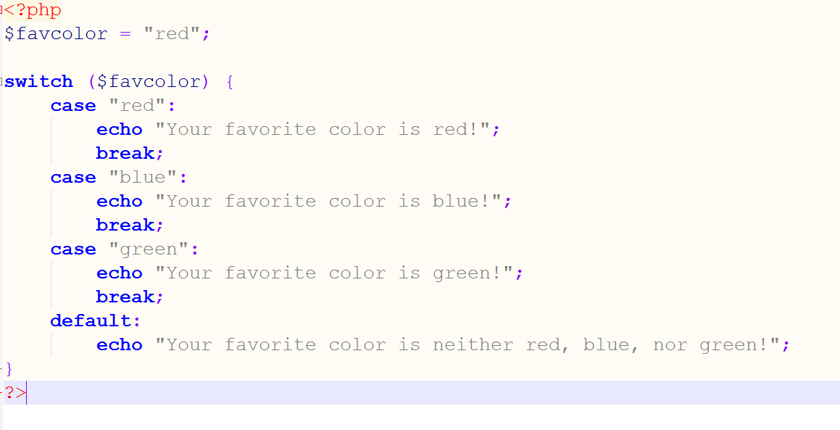

Slide 40
7. WHILE
Syntax: WHILE (condition) {
Statements’
}

Slide 41
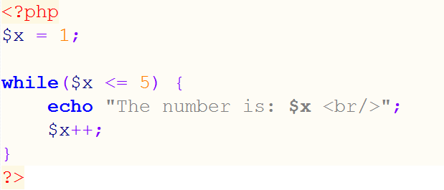

Slide 42
Introduction
6. DO WHILE
Syntax: DO {
Statements;
} WHILE condition

Slide 43
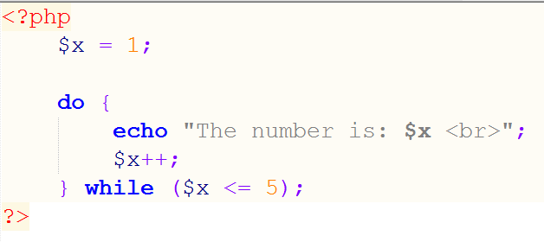

Slide 44
8. FOR
Syntax:
a) FOR (initial condition; final condition; increment) {
Statements;
}
b) FOR (initial condition; final condition; decrement) {
Statements;
}

Slide 45
